Slide 1
Welcome!
‹#›

Slide 2
7.1 Array Basics
7.2 Array Traversal Algorithms
PROFESSOR RAMSEY
GDC 6.318
ramsey@cs.utexas.edu
Notes:
draw memory at some point with local memory only having an address and heap having values

Slide 3
Announcements
TBD

Slide 4
Quiz

Slide 5
It’s OK to spend time in the German forest. Once you get out a few times, you know you will get out again.
Surviving the German Forest

Slide 6
7.1
Array Basics

Slide 7
Demo
Demo 1
All is good and well.
Until you want to use the temperatures for something else like, how many days were above average?
Giving each temperature a name like temp1, temp2, temp3, only work for a very small number of temps.

Slide 8
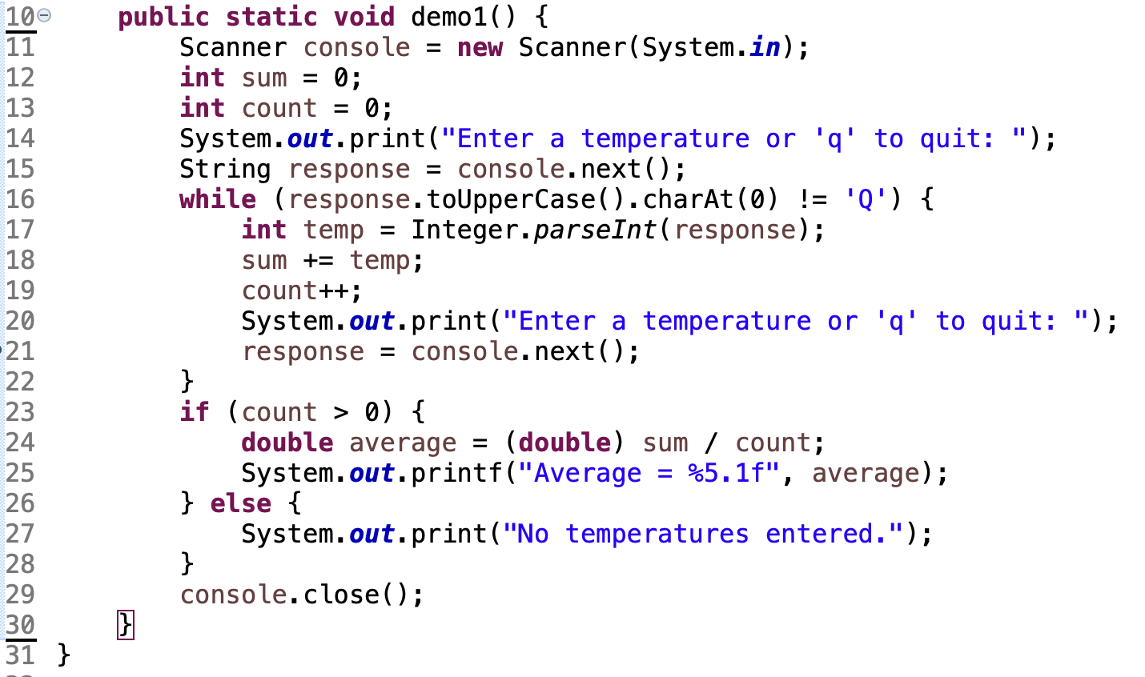
Demo Code

Slide 9
The Trouble with Primitive Types
Primitive Types: boolean, int, double, char, and sometimes String
Primitive Types can’t:
represent large amounts of data
represent relationships between data

Slide 10
What I Wish For…
One variable called temps that holds all the temperatures. Use this as a parameter, return value, etc.
Multiple variables, like temp1, temp2, so I can access each individual temperature.

Slide 11
My Wish Has Come True…
array: object that stores many values of the same type.
element: One value in an array.
index: A 0-based integer to access an element from an array.
index | 0 | 1 | 2 | 3 | 4 | 5 | 6 | 7 | 8 | 9
value | 12 | 49 | -2 | 26 | 5 | 17 | -6 | 84 | 72 | 3
temps
temp 0
temp 4
temp 9

Slide 12
Creating an Array
type[] name = new type[length];
Example:
// Creates array of size 10
// Indexes 0 - 9
// Initializes each item to 0
int[] temps = new int[10];
index | 0 | 1 | 2 | 3 | 4 | 5 | 6 | 7 | 8 | 9
value | 0 | 0 | 0 | 0 | 0 | 0 | 0 | 0 | 0 | 0
temps

Slide 13
More About Creating an Array
The length can be any integer expression.
int x = 2 * 3 + 1;
int[] data = new int[x % 5 + 2];
Each element initially gets a "zero-equivalent" value.
Type | Default value
int | 0
double | 0.0
boolean | false
String or other object | null (means, "no object")

Slide 14
Accessing Elements
name[index] // access
name[index] = value; // modify
Example:
numbers[0] = 27;
numbers[3] = -6;
System.out.println(numbers[0]);
if (numbers[3] < 0) {
System.out.println("Element 3 is negative.");
}
index | 0 | 1 | 2 | 3 | 4 | 5 | 6 | 7 | 8 | 9
value | 27 | 0 | 0 | -6 | 0 | 0 | 0 | 0 | 0 | 0

Slide 15
The length Field
An array's length field stores its number of elements.
name.length
for (int i = 0; i < numbers.length; i++) {
System.out.print(numbers[i] + " ");
}
// output: 0 2 4 6 8 10 12 14
It does not use parentheses like a String's .length().
What expressions refer to:
The last element of any array?
The middle element?

Slide 16
Demo
Demo 2
Rewrite demo 1 to use an array.
View the array in the debugger.

Slide 17
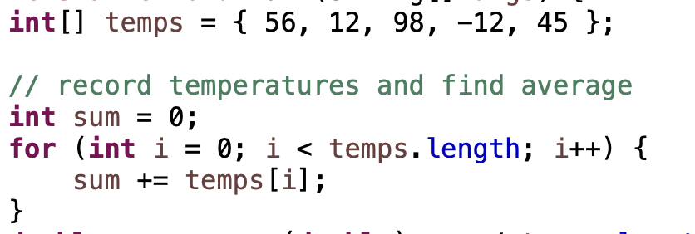
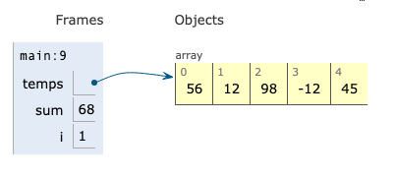
Python Tutor

Slide 18
Arrays of Other Types
double[] results = new double[5];
results[2] = 3.4;
results[4] = -0.5;
boolean[] tests = new boolean[6];
tests[3] = true;
index | 0 | 1 | 2 | 3 | 4
value | 0.0 | 0.0 | 3.4 | 0.0 | -0.5
index | 0 | 1 | 2 | 3 | 4 | 5
value | false | false | false | true | false | false

Slide 19
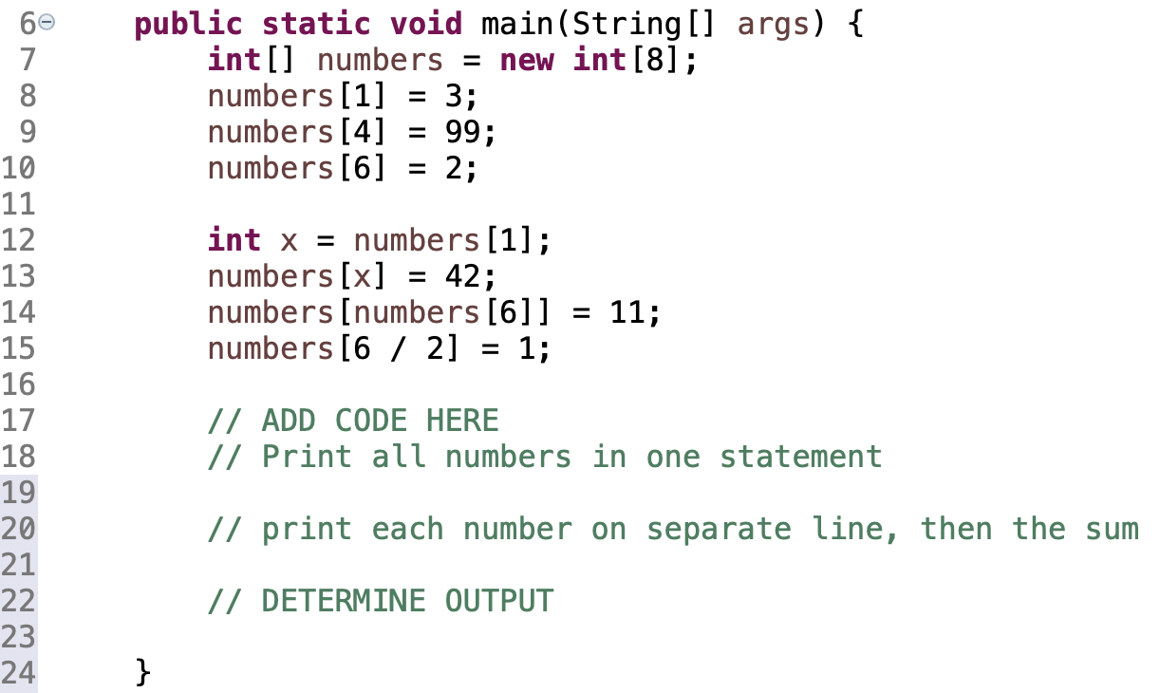
In-Class Practice
Output for a different numbers array:
[9, -4, 2]
Num 1: 9
Num 2: -4
Num 3: 2
The sum is: 7

Slide 20
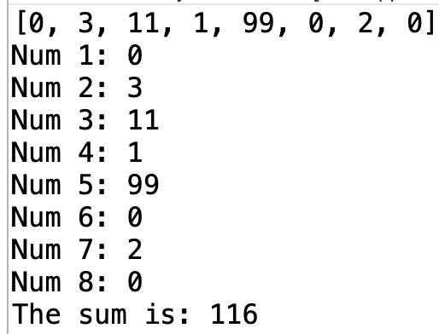
Solution

Slide 21
Demo
Demo 3
All sorts of ways to get in trouble.

Slide 22
Demo Code - Fixed
The standard array traversal loop

Slide 23
The Traversal - Arrays and For Loops
It is common to use for loops to access array elements.
for (int i = 0; i < 8; i++) {
System.out.print(numbers[i] + " ");
}
System.out.println(); // output: 0 4 11 0 44 0 0 2
Sometimes we assign each element a value in a loop.
for (int i = 0; i < 8; i++) {
numbers[i] = 2 * i;
}
index | 0 | 1 | 2 | 3 | 4 | 5 | 6 | 7
value | 0 | 2 | 4 | 6 | 8 | 10 | 12 | 14

Slide 24
Out-of-Bounds
Legal indexes: between 0 and the array's length - 1.
Reading or writing any index outside this range will throw an ArrayIndexOutOfBoundsException.
Example:
int[] data = new int[10];
System.out.println(data[0]); // okay
System.out.println(data[9]); // okay
System.out.println(data[-1]); // exception
System.out.println(data[10]); // exception
index | 0 | 1 | 2 | 3 | 4 | 5 | 6 | 7 | 8 | 9
value | 0 | 0 | 0 | 0 | 0 | 0 | 0 | 0 | 0 | 0

Slide 25
Practice 2
What is the output?
In-Class Practice

Slide 26
Solution

Slide 27
Array Limitations
You cannot resize an existing array:
int[] a = new int[4];
a.length = 10; // error
You cannot compare arrays with == or equals:
int[] a1 = {42, -7, 1, 15};
int[] a2 = {42, -7, 1, 15};
if (a1 == a2) { ... } // false!
An array does not know how to print itself:
int[] a1 = {42, -7, 1, 15};
System.out.println(a1); // [I@98f8c4]

Slide 28
Java Arrays Class Methods
import java.util.*;

Slide 29
6.2
Array Traversal Algorithms

Slide 30
In-Class Practice
calling code:
output:
Method: intsEqual(), works with calling method above
Purpose: determine if two integer arrays have identical contents.
Parameters: two integer arrays
Return: True if arrays have equal content, otherwise false
(Imagine Array.equals() doesn’t exist.)

Slide 31
Solution

Slide 32
In-Class Practice
calling code:
output:
Method: reverseArray(), works with calling method above
Purpose: determine if two integer arrays have identical contents.
Parameters: two integer arrays
Return: True if arrays have equal content, otherwise false
(Imagine Array.equals() doesn’t exist.)

Slide 33
Solution

Slide 34
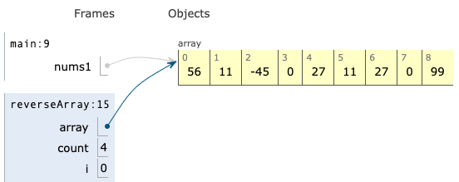
Just in - Memory News
Inside the reverseArray() method:
After the reverseArray() method returns:

Slide 35
Remember
You Belong Here
Hi!

